Slide 1
Organic Chemistry
Alkanes, Alkenes, Alkynes, Cyclic hydrocarbons, Isomers, Benzene

Slide 2
Organic Chemistry
An organic compound is based on carbon atoms, usually contains hydrogen too, and may also contain other non-metal atoms such as oxygen, nitrogen & sulfur.
Typical organic compounds:
have covalent bonds
have low melting points
have low boiling points
are flammable
are soluble in nonpolar solvents
are not soluble in water

Slide 3
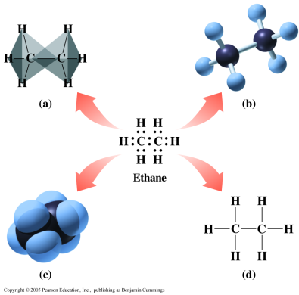
Bonding of Carbon
Carbon has:
4 valence electrons
forms 4 covalent bonds.
tetrahedral shape.
In molecules with two or more carbon atoms, each carbon atom with four single bonds has a tetrahedral shape.

Slide 4
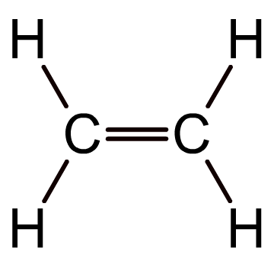
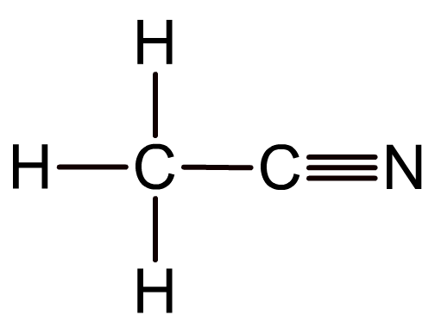
Structural Formula
Structural formula shows arrangement of atoms in and all the bonds.
Single bonds:
single line
Double bonds:
two lines
Triple bonds
three lines.
Structural vs Condensed vs Molecular vs Line

Slide 5
Alkanes
General formula
C_{n}H_{2n+2}
Names ending –ane.
Contain only single carbon–carbon bonds
Are saturated.
Cycloalkanes
C_{n}H_{2n}
No. of carbon atoms
Molecular formula
Name
1
CH₄
methane
2
C₂H₆
ethane
3
C₃H₈
propane
4
C₄H₁₀
butane
5
C₅H₁₂
pentane
6
C₆H₁₄
hexane

Slide 6
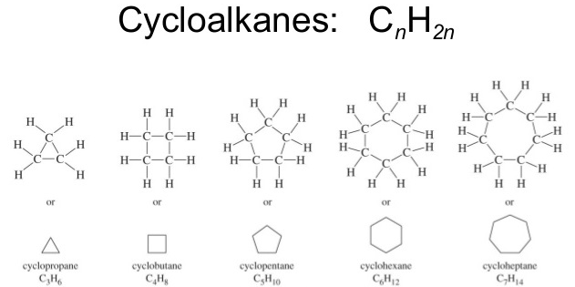
Cycloalkanes
General formula
C_{n}H_{2n}
Names:
Beginning cyclo-
Ending with –ane.
Only single carbon–carbon bonds
Saturated

Slide 7
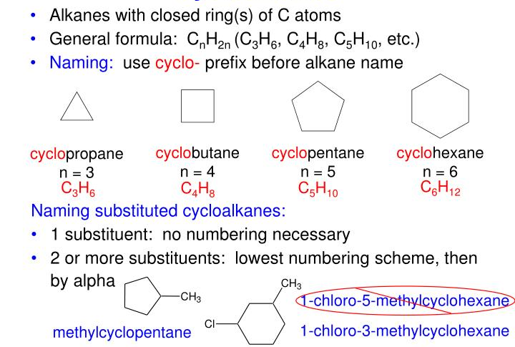
Cycloalkanes

Slide 8
Alkenes
General formula
C_{n}H_{2n}
Names ending –ene.
Contain at least one carbon–carbon double bond
Are unsaturated.
No. of carbon atoms
Molecular formula
Name
2
C₂H₄
ethene
3
C₃H₆
propene
4
C₄H₈
butene
5
C₅H₁₀
pentene
6
C₆H₁₂
hexene

Slide 9
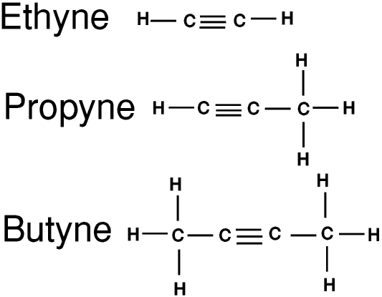
Alkynes *
General formula
C_{n}H_{2n-2}
Names ending –yne.
Contain at least one carbon–carbon triple bond
Are unsaturated.

Slide 10
Isomerism
Isomers - Same molecular formula but atoms are arranged in a different way.
Structural isomerism
Different structural formula
Chain
Positional
Stereoisomerism
Same structural formula but different 3D arrangement
Cis and Trans isomers.

Slide 11
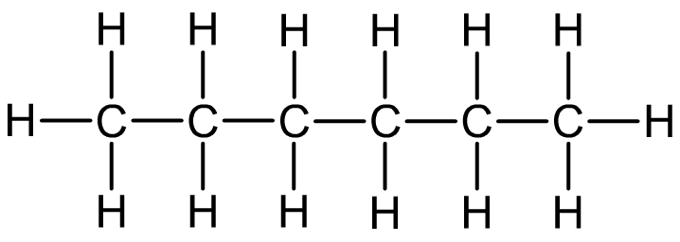
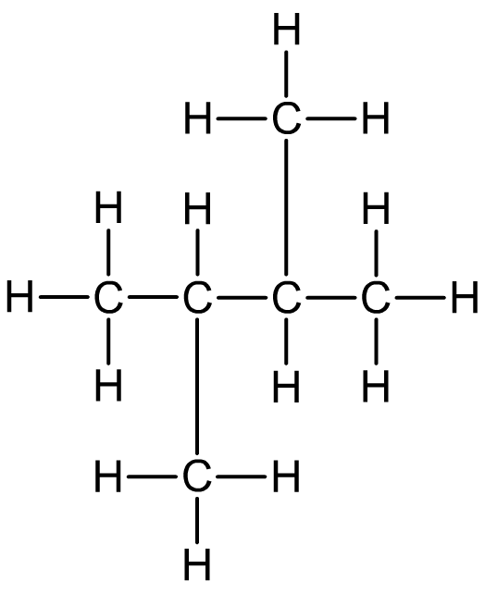
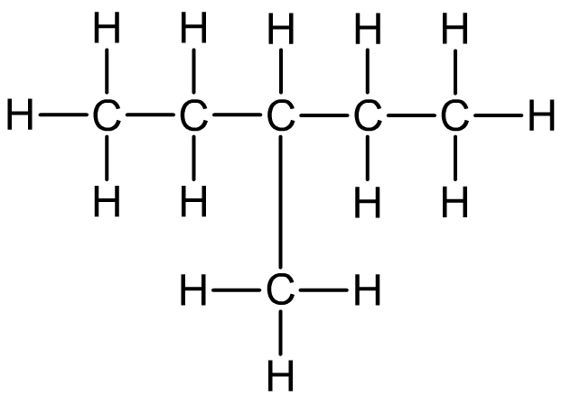
Isomers of C₆H₁₄
hexane
2,3-dimethylbutane
3-methylpentane

Slide 12
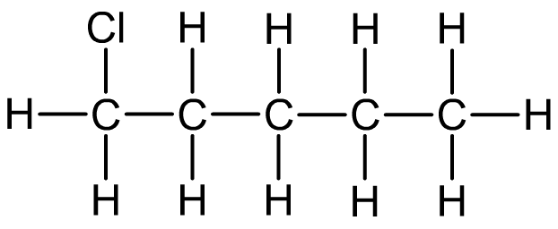
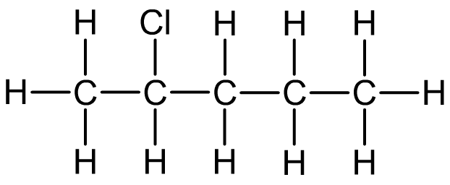
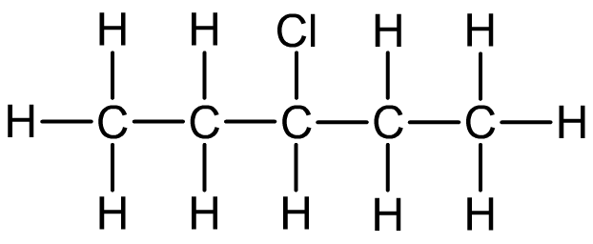
Isomers of C₅H₁₁Cl
1-chloropentane
2-chloropentane
3-chloropentane

Slide 13
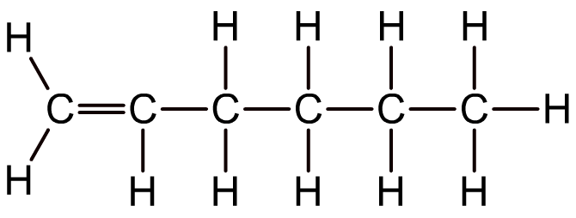
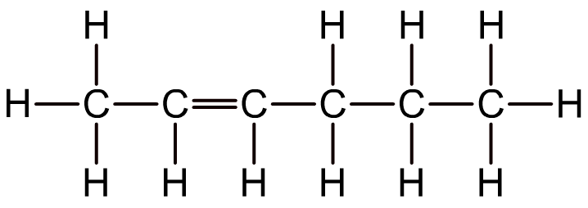
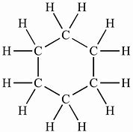
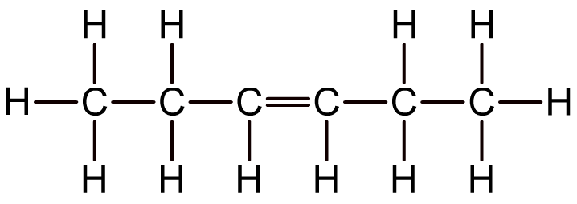
Isomers of C₆H₁₂
hex-1-ene
hex-2-ene
hex-3-ene
Cyclohexane

Slide 14
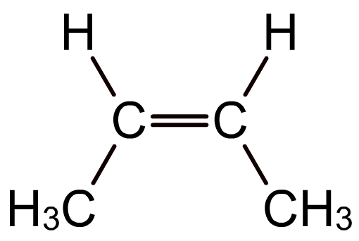
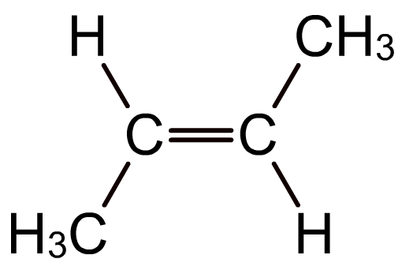
Isomers of Alkenes
Rotation around single C-C covalent bonds, but not around C=C double bonds.
Stereoisomerism or cis–trans isomerism
These isomers cannot be superimposed on each other because the arrangement of the methyl groups is different.
is not the same as
cisbut-2-ene
C₄H₈
transbut-2-ene

Slide 15


Isomers of C₆H₁₂
cis-hex-2-ene
Can you draw the structures for cis and trans hex-3-ene
trans-hex-2-ene

Slide 16
Isomers of C₆H₁₂
hex-1-ene
hex-2-ene
cis-hex-2-ene
hex-3-ene
trans-hex-2-ene
Cyclohexane

Slide 17
Isomer Problem
Molecular Formula: C₂H₂Cl₂
Alkane or Alkene?
Isomers?
Chain/positional?
Stereoisomers (cis/trans)
Draw all structures
Name them all

Slide 18

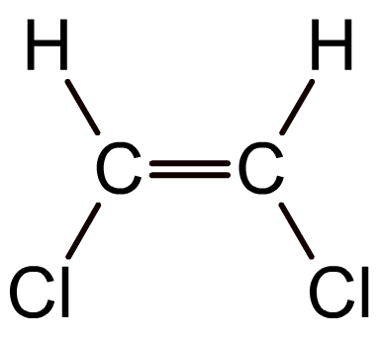
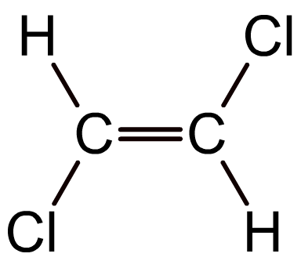
Isomer problem
1,1-dichloroethene
cis-1,2-dichloroethene
trans-1,2-dichloroethene

Slide 19
Isomer Problem
Molecular Formula: C₄H₇Cl
Alkane or Alkene?
Isomers?
Chain/positional?
Stereoisomers (cis/trans)
Draw all structures
Name them all

Slide 20
Isomer Problem C₄H₇Cl
There are 12 isomers
1-chlorobut-1-ene
2-chlorobut-1-ene
3-chlorobut-1-ene
4-chlorobut-1-ene
cis-1-chlorobut-2-ene
trans-1-chlorobut-2-ene
cis-2-chlorobut-2-ene
trans-2-chlorobut-2-ene
1-chloro-2-methylprop-1-ene
3-chloro-2-thehylprop-1-ene
chlorocyclobutane
(chloromethyl)cyclopropane **
Reference
https://www.molport.com/shop/search-results?searchkey=645VTO2IO6R6J1CF4IUOU9&searchtype=text-search

Slide 21
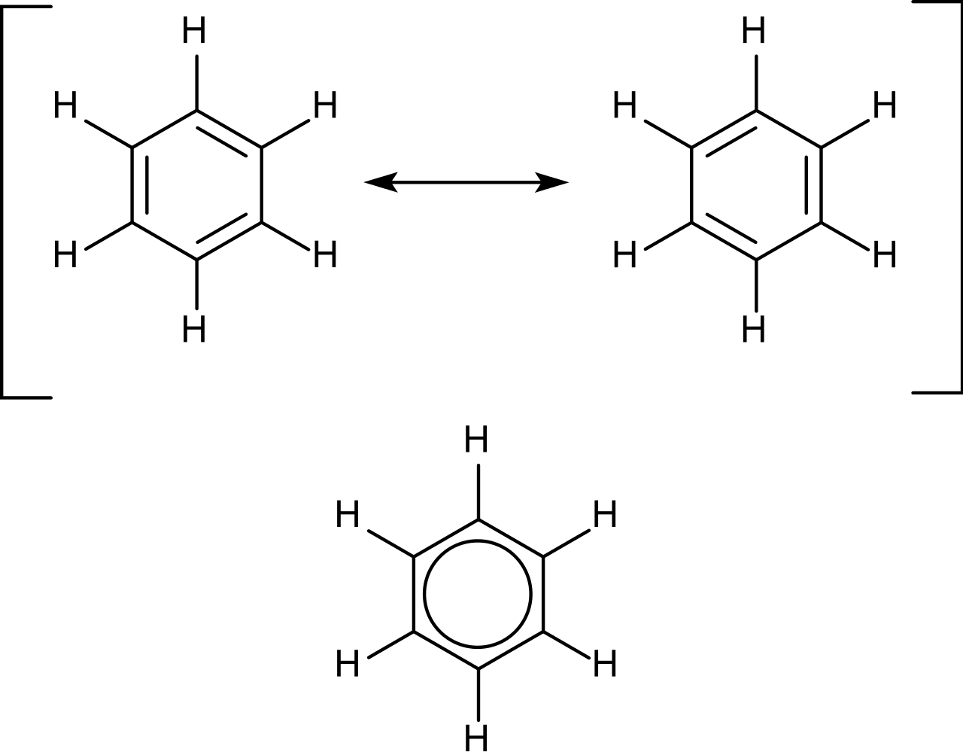
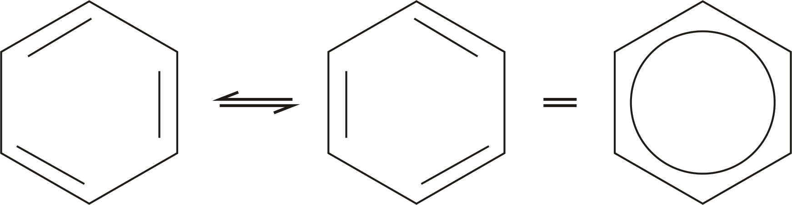
Benzene
Resonance structures of benzene due to conjugation of bonds
Conjugation – is alternating adjacent double/single bonds.
Caused by overlap of one p-orbital with another p-orbital across a sigma-bond.
The pi electrons become delocalized about a group of atoms.
Electrons are more stable
Benzene is less reactive (ie releases MORE energy when combusted)

Slide 22
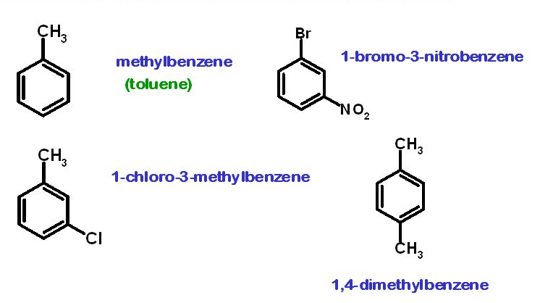
Benzene

Slide 23
IUPAC Nomenclature
IUPAC = International Union of Pure and Applied Chemistry

Slide 24
Objectives
Name Alkanes and Cycloalkanes correctly
With halogen and alkyl substituents
Name Alkenes and Cycloalkenes correctly
With halogen and alkyl substituents
Name polysubstituted Benzenes correctly
With halogen and alkyl substituents
Draw structural and geometric isomers and name each correctly

Slide 25
IUPAC Nomenclature
Establish and international standard of naming compounds to facilitate communication.
Each structure should have a name that is unique and unambiguous (e.g. isomers)
Fundamental Principle: naming is based off a molecules longest chain of carbon atoms connected by single bonds in a chain or in a ring. All deviations (e.g. multiple bonds or substituents) are indicated by prefixes or suffixes.

Slide 26
Alkanes and Cycloalkanes
The number of carbons in the chain is indicated by a Greek or Latin prefix. “cyclo” is attached to the beginning of the prefix for cycloalkanes.
No. of C |  | No. of C
1 | Methane | 10 | Decane
2 | Ethane | 11 | Undecane
3 | Propane | 12 | Dodecane
4 | Butane | 13 | Tridecane
5 | Pentane | 14 | Tetradecane
6 | Hexane | 20 | Icosane
7 | Heptane | 21 | Henicosane
8 | Octane | 22 | Docosane
9 | Nonane | 23 | Tricosane

Slide 27
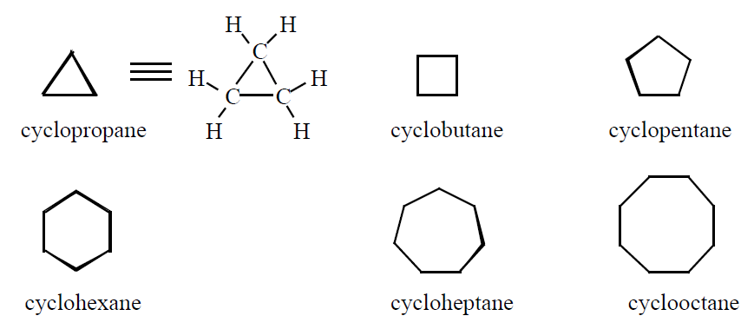
Cycloalkanes

Slide 28
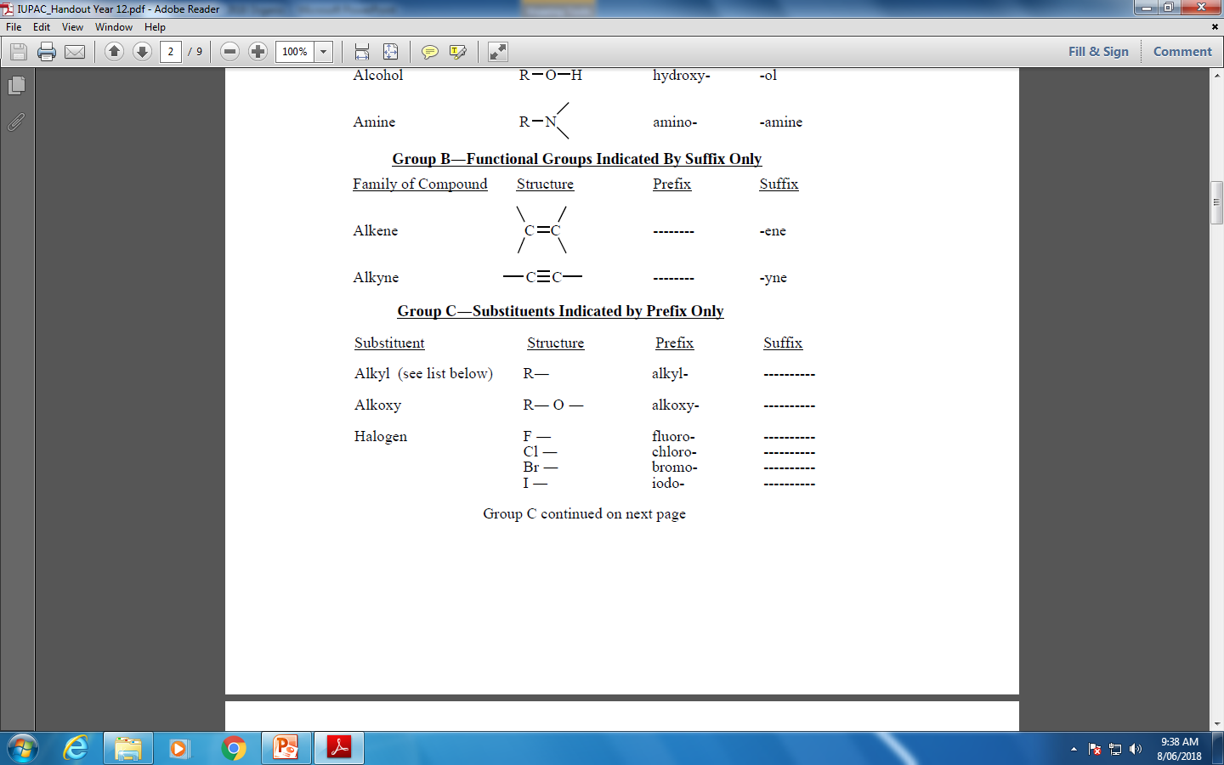
Halogen Substituents
If a halogen is substituted onto an organic molecule, use the prefix that corresponds to the halogen:

Slide 29
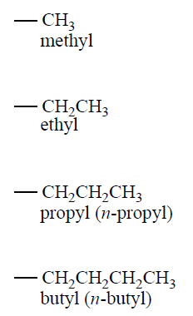
Alkyl substituents
Sometimes there are branches of carbon atoms which are attached to the longest chain carbon chain.
In these cases we use the longest chain to name the alkane and then signify the alkyl branch.
Replace –ane with –yl to name the substituent

Slide 30
Naming Alkanes and cycloalkanes
Find the longest carbon chain and determine the root name for the parent chain. In cyclic compounds the ring is usually considered the parent chain.
Number the carbon atoms in the direction such that the first substituent has the lowest number. (if equal then use the second substituent).
Determine the name and position of each substituent.
Indicate the number of identical groups by prefixes di, tri, tetra, etc.
Place the substituents in alphabetical order before the root name. (alphabetical for only the substituent not prefixes).
NOTE: place numbers preceded and followed by - -.

Slide 31
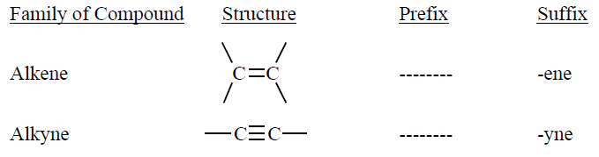
Alkenes
A carbon-carbon double bond indicates there is an alkene functionality in the organic molecule.
For alkenes we use the suffix –ene rather than –ane

Slide 32
Naming Alkenes and cycloalkenes
Follow the same rules for naming alkanes except:
Number the chain of carbons such that the C=C bond has the lower position number (it has higher priority than substituents).
Change –ane to –ene in the root name and assign a position number (e.g. hex-3-ene).
Designate geometrical isomers cis-, trans-
** NOTE: for multiple double bonds use –diene, -triene etc.**

Slide 33
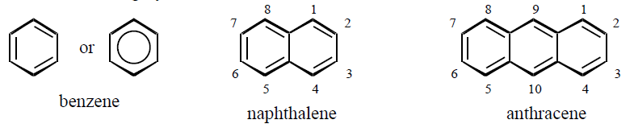
Naming Benzenes
Parent aromatic rings

Slide 34
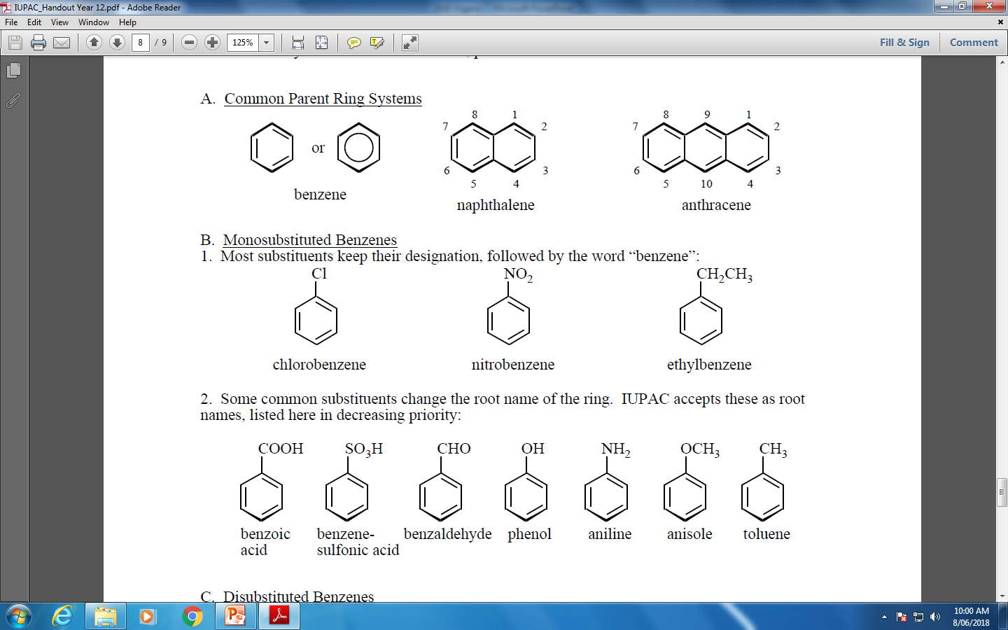
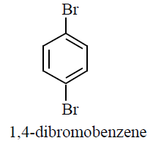
Naming Benzenes
Substituents keep their prefix followed by “benzene”

Slide 35
Practice
STAWA Set 40 – Naming and Drawing hydrocarbons (p 198-203)
Lucarelli Chapter 12 Set 20 – Hydrocarbons: Nomenclature and structure (p 96-99)

